Slide 1
TOPIC-TITANIC SURVIVAL PREDICTION
NAME-SANJAY SHOME
BATCH:- 1 AT23

Slide 2
Business objective
1) The Titanic survival prediction project aims to analyze various factors influencing the survival of passengers aboard the Titanic.
2) The ultimate goal is to gain insights into the dynamics of survival on the Titanic and to develop a reliable model for predicting survival outcomes.
3) The Titanic survival prediction project aims to analyze various factors influencing the survival of passengers aboard the Titanic.

Slide 3
DATA DRIVEN QUESTION
Data cleansing involves removing unnecessary columns.
Giving the columns new names.
Eliminating redundant entries.
Santitzing specific columns.
Eliminating the dataset’s NaN values.
Look for a few more changes if necessary.

Slide 4
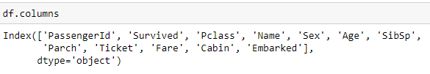
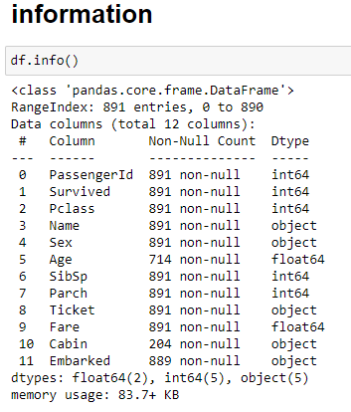
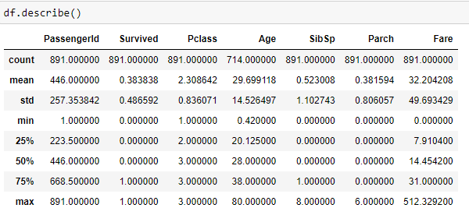
Basic information and understanding about the data

Slide 5
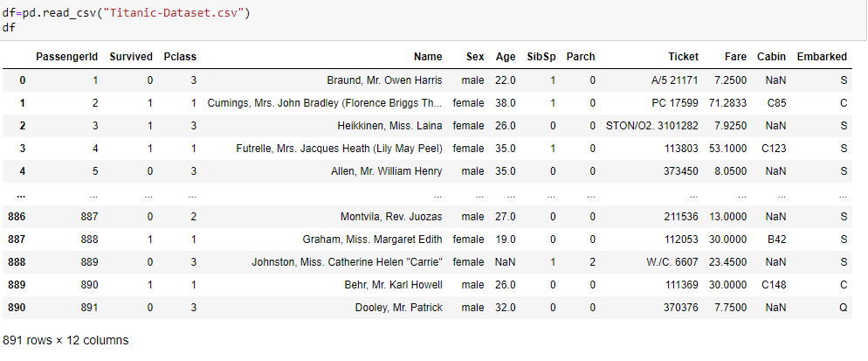
IMPORT AND LOAD THE DATA

Slide 6
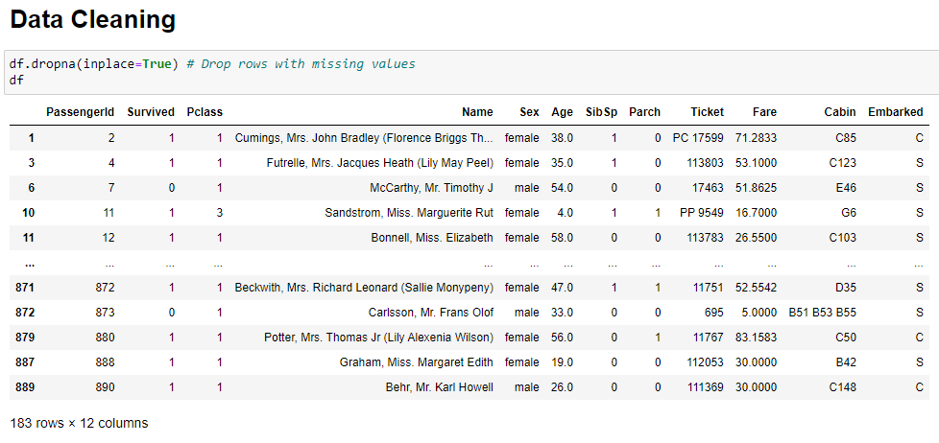
1) Data cleaning involves removing uncessary columns

Slide 7
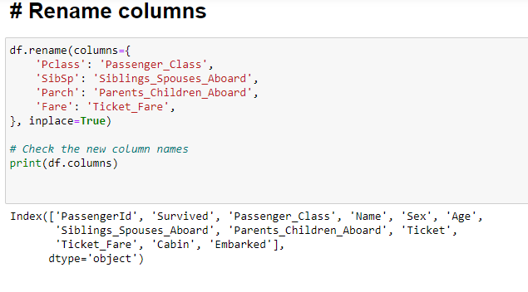
2) Giving the columns new names

Slide 8
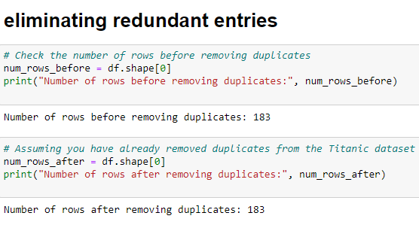
3) Eliminating Redundant entries

Slide 9
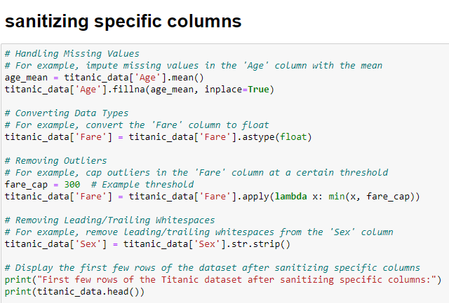
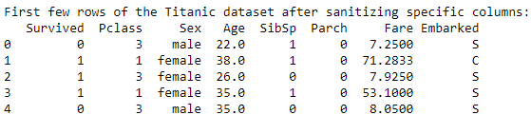
4) Sanitizing specific columns

Slide 10
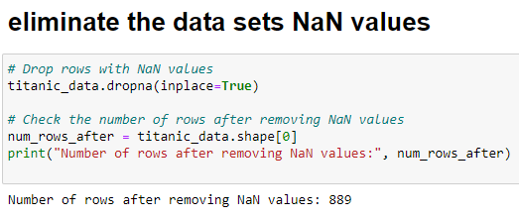
5) Eliminate the data set’s NaN values.

Slide 11
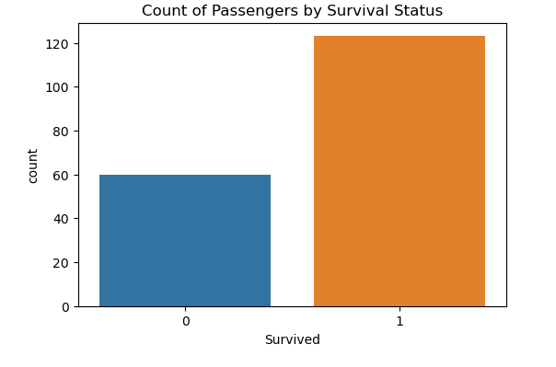
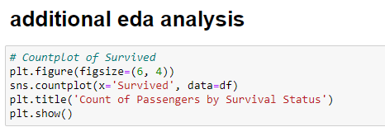
6) Look for a few more changes if necessary

Slide 12
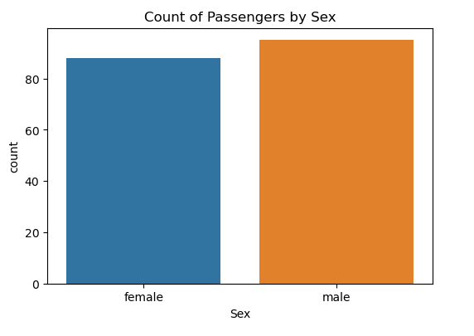
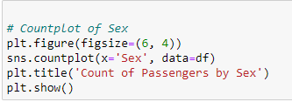
Count plot of sex

Slide 13
THANK YOU

